Slide 1
Data Science for Internet of Things Case Study: Smart Home Devices
Olivera Kotevska, PhD
kolivera@ieee.org

Slide 2
Goal of this tutorial
Presents what is Internet of Things (IoT)
Eco system, protocols, architectures, and challenges
Presents some of the IoT vulnerabilities
Vulnerabilities of IoT - security and privacy aspects
Overview at some of the methods to overcome these vulnerabilities
Use a practical example of Smart Home network
Present a set of methods for analyzing IoT network behavior

Slide 3
Outline
Theoretical part
IoT systems
Challenges
Ways to overcome some of those challenges
Role of data science in IoT network traffic - Approaches: Pattern detection, Classification
Practical part - Use case: Smart Home network
Setting up the environment using R and RStudio environment
Set of data science algorithms for IoT network analysis using R & R Studio
Takeaways
Few things to remember
References

Slide 4

Internet of Things (IoT) – history and definition
First mentioned in 1999 by Kevin Ashton during his work at Proctor & Gamble.
IoT is a network of things which enables these things to connect and exchange data, resulting in efficiency improvements.
Things refers to wide variety of objects – devices, systems, or human.
The resemblance between all IoT things is the ability to connect to the Internet.
IoT has been called the Third Wave in information industry.
https://appsec-labs.com/iot-security/

Slide 5
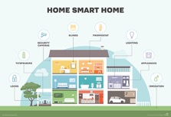
Areas of IoT
General classification areas based on target audience (Individuals, Society, Industry):
Smart Buildings, Office and Homes
Smart Energy meters
Smart Agriculture and Water monitoring
Water levels
Smart Manufacturing and Industry
Industrial asset monitoring
Smart Mobility and Transport
Smart Health and Medicine
Fitness trackers
Smart Home
Temperature adjustments
Tenzin, S. et al. (2017) KST, 172-177.
http://www.exchangecommunications.co.uk
https://www.i-scoop.eu/
https://brewcitypc.com/home-services/

Slide 6
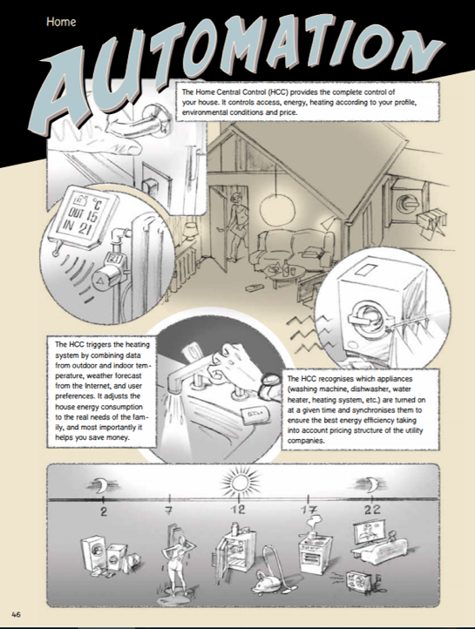

The IoT Comic Book is a result of the EU Internet of Things Initiative.
https://iotcomicbook.org/

Slide 7
Growing number of IoT devices
General goals of IoT are to:
Maximize health and safety
Maximizing the convenience of its execution while minimize the amount of work
Minimize the costs
“The number of IoT devices increased 31% year-over-year to 8.4 billion in 2017 and it is estimated that there will be 30 billion devices by 2020¹.”
¹ Nordrum, Amy (18 August 2016). "Popular Internet of Things Forecast of 50 Billion Devices by 2020 Is Outdated". IEEE.

Slide 8
Understanding the IoT eco system
A high-level system model of IoT
The whole task of IoT is:
IoT devices collect the information from the environment
knowledge should be extracted from the raw data
the data will be ready for transfer to other objects, devices, or servers through the Internet
IoT includes four main components: sensors, networks, analyzing data, monitoring the system.
Ammar, M., Russello, G., & Crispo, B. (2018). Internet of Things: A survey on the security of IoT frameworks. Journal of Information Security and Applications, 38, 8-27.

Slide 9
1. IoT Sensors
Connectivity capabilities
Reach the outside world (e.g. cloud) directly e.g. phone
Others must connect to a hub or gateway first e.g. smart camera
Processing capabilities
Processing on the sensor
Processing on the hub or cloud
Combination between both
Gope, P., & Hwang, T. (2016). IEEE Sensors Journal, 16, 1368-1376.
Temperature sensor
Motion sensor
Door & window sensor
Raspberry Pi

Slide 10
2. IoT Network
IoT communication protocols
Device to Device
Device to Server
Server to Server
Networks characteristics
All network topologies are supported – star, mesh, device-to-device
Wide range of verticals with specific network requirements
Wide variety of devices of different capabilities
Al-Fuqaha, A., Guizani, M., Mohammadi, M., Aledhari, M., & Ayyash, M. (2015). Internet of things: A survey on enabling technologies, protocols, and applications. IEEE Communications Surveys & Tutorials, 17(4), 2347-2376.

Slide 11
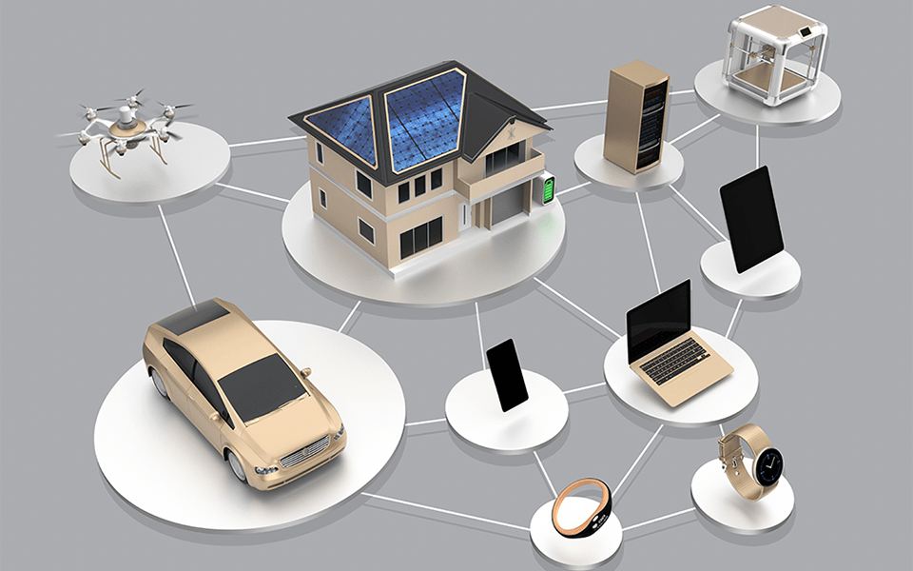
IoT Network
Integration of multiple network standards and protocols
Short range networks
RFID, NFC, Bluetooth, Ant, EnOcean, Z-Wave, Insteon, ZigBee, MiWi, DigiMesh, WirelessHART, Thread, 7LowPAN, Wi-Fi
Long range networks
LoRaWAN, Symphoney Link, Weightless, SIGFOX, DASH7
ZigBee
LoRaWAN
Wi-Fi
Wi-Fi
Bluetooth
Bluetooth
https://www.nist.gov/blogs/taking-measure/cybersecuring-internet-things

Slide 12
IoT vs Non-IoT network traffic
IoT network traffic
Environmental characteristics
heterogeneous, nonlinear, distributed
Data characteristics
volume, variety, variability, data types
Traffic patterns change more frequently
Non-IoT network traffic
Environmental characteristics
homogeneous
Data characteristics
volume
Traffic patterns are more consistent
“The availability of IoT traffic not only creates new application opportunity's such as remote camera monitoring, but it changes the distribution of Internet traffic e.g. recent study shows that video streaming via Netflix accounts for 32.7% of peak downstream traffic in US.” ¹
¹ https://www.cnn.com/2011/10/27/tech/web/netflix-internet-bandwith-mashable/index.html

Slide 13
3. IoT Analysis
Refers to analyzing and examining the data obtained by the IoT
Key components of collection of IoT data - sensors, network end devices, and other data storing and transmitting equipment
It is a service that runs and operationalize sophisticated analytics on massive volumes of IoT data.

Slide 14
3. IoT Analysis - Traffic characteristics
Transmission characteristics
At anytime of the day
From locations not accessible to humans
May be coordinated, synchronized
Periodic or event-driven
Real time and non-real time
Sleep time
Short and small packets
Properties
Network size & Message size
Traffic rate & interval
Demands on QoS
Energy source
https://www.ericsson.com/en/mobility-report/massive-iot-in-the-city

Slide 15
4. IoT system monitoring – life cycle
Act
Sense
Analyze (Store, Process)
Visualize
Communicate

Slide 16
... but there is a dark side – some of IoT challenges
Hardware
Cost of devices, battery life, physical specifications
Communication and networking
Coverage - High complexity of distributed computing
Scalability and diversity - Various communication protocols
Reliability
Software
Interoperability, data processing, context awareness
Security
C.I.A. – Confidentiality, Integrity, and Availability
Attack resistance
Zhang, Z. K. et al.(2014, November). IoT security: ongoing challenges and research opportunities. In Service-Oriented Computing and Applications (SOCA), 2014 IEEE 7th International Conference on (pp. 230-234). IEEE.

Slide 17
IoT Security risks
Number of IoT device and gadgets develops each day so the security danger and potential difficulties are likewise develops alongside that.
Potential vulnerabilities are:
User based
Node capture and eavesdropping
Controlling the data
Access attacks and privacy attacks
System based
Distribution and denial-of-service attacks
Complexity of vulnerability
Bandwidth constraints
Mendez, D. M., Papapanagiotou, I., & Yang, B. (2017). Internet of things: Survey on security and privacy. arXiv:1707.01879.

Slide 18
Famous cybersecurity attacks
Massive target hack and the security breach at Equifax which comprised sensitive personal information. (2017)
Mirai Botnet (aka Dyn Attack) – affected computers continually search the internet for vulnerable IoT devices and then use known default usernames and passwords to login, infecting them with malware. These devices were things like digital cameras and DVR players. (2016)
Other attacks related to health and human well-being are:
In Finland cybercriminals shut down the heating of two buildings in the city. (2016)
FDA confirmed that St. Jude Medical’s implantable cardiac devices have vulnerabilities that could allow a hacker to access a device. (2017)

Slide 19
IoT security architecture
Jing, Q., Vasilakos, A. V., Wan, J., Lu, J., & Qiu, D. (2014). Security of the Internet of Things: perspectives and challenges. Wireless Networks, 20(8), 2481-2501.

Slide 20
Application layer characteristics
Application layer – setting and ensuring common grounds - reaching the applications - for communication
Users can access to the IoT through the application layer interface using TV, PC, mobile equipment and so forth
It provides the personalized services according to the needs of the users
Can be thought of as the one that users interact with and as the one witch defines how process-to-process communications take place

Slide 21
Protocols in different layers
TCP/IP | OSI Model | Protocols
Application layer | Application layer | DNS, DHCP, FTP, HTTP(S), IMAP, NTP, POP3, SMTP, SNMP, TFTP, Telnet, RTP, RTSP, CoAP, MQTT, XMPP, AMQP
 | Presentation layer | JPEG, MIDI, MPEG, PICT, TIFF
 | Session layer | NetBIOS, NFS, PAP, SCP, SQL, ZIP
Transport layer | Transportation layer | TCP, UDP
Internet layer | Network layer | ICMP, IGMP, IPsec, IPv4/IPv6, IPX, RIP
Link layer | Data Link layer | ARP, ATM, CDP, FDDI, Frame Relay, HDLC, MPLS, PPP, STP, Token Ring
 | Physical layer | Bluetooth, Ethernet, DSL, ISDN, 802.11 Wi-Fi
Protocols are required in order to identify the spoken language of the IoT devices
Dizdarevic, J. et. al. (2018). Survey of Communication Protocols for Internet-of-Things and Related Challenges of Fog and Cloud Computing Integration. arXiv preprint arXiv:1804.01747.

Slide 22
IoT data characteristics and challenges
Data collection challenges
Smart devices generate data on a continuous manner
Data generation varies for different devices – processing data with different generation rates is a challenge
Heterogeneous sources
Dynamic nature of data – moving sensors like cars
Quality of collected data
Error in measurements or precision of data collection
Devices’ noise in the environment
Discrete observation and measurement
Trustworthy sources
Mahdavinejad, M. S. et al. (2017). Machine learning for Internet of Things data analysis: A survey. Digital Communications and Networks.

Slide 23
Analytical capabilities
Intelligent processing and analysis of the data is the key to developing smart IoT applications.
Classification of analytical capabilities consisting of five categories:
Descriptive – What happened?
Diagnostic – Why something has happened?
Discovery – What happened that we don’t know about?
Predictive – What is likely to happen?
Prescriptive – What if?
The need to deal with network traffic patterns, large datasets and multidimensional spaces of flow and packet attributes is one of the reasons for using ML in this field.
Siow, E., Tiropanis, T., & Hall, W. (2018). Analytics for the Internet of Things: A Survey. ACM Computing Surveys (CSUR), 51(4), 74.

Slide 24
What is Data Science (DS)?
DS uses scientific methods, processes, algorithms and systems to extract knowledge and insights from data
DS employs techniques and theories from many fields including machine learning (ML)
ML is a the process of finding and describing structural patterns in a supplied dataset
ML takes input an the form of dataset of instances
Each instance is characterized by the values of its features
Different styles of learning
Descriptive
Discovery
Diagnostic
Predictive

Slide 25
ML approach to IoT traffic analysis (1/2)
Essential concepts for determining right algorithms to use
IoT application
Privacy of collected data
Security parameters such as network security, and data encryption
IoT data characteristics
Volume, velocity, varieties of data, quality of data
IoT data analytics algorithms - data-driven vision of ML algorithms
Analyze the data from variety of sources in real time
Algorithms that tolerate noisy data
Algorithms that can work with small amount of labeled data
Xiao, L., Wan, X., Lu, X., Zhang, Y., & Wu, D. (2018). IoT Security Techniques Based on Machine Learning. arXiv preprint arXiv:1801.06275.
Mahdavinejad, M. S., Rezvan, M., Barekatain, M., Adibi, P., Barnaghi, P., & Sheth, A. P. (2017). Machine learning for Internet of Things data analysis: A survey. Digital Communications and Networks.

Slide 26
ML approach to IoT traffic analysis (2/2)
Traffic measurements in operational networks help to
understand traffic characteristics in deployed networks
develop traffic models
evaluate performance of protocols and applications
Traffic analysis
provides information about the user behavior patterns
enables network operators to understand the behavior of network users
Traffic prediction
important to assess future network capacity requirements and to plan future network developments

Slide 27
Most used ML approaches for IoT traffic analysis
ML biggest strength in security is training to understand what is "baseline" or "normal" for a system, and then flagging anything unusual for human review.
In order to draw the right decision for data analysis, it is necessary to determine which one of the tasks whether:
Understanding the data / Pattern detection
Dynamic over time
Communication among devices
Traffic similarity between devices
Identify the features that characterize the importance of the specific device traffic
Destination IP, Number of packets
Classify each device and device type

Slide 28
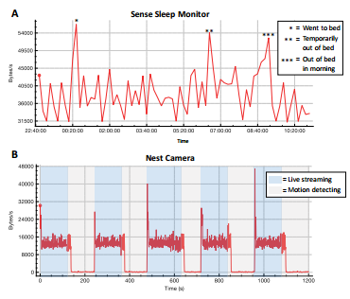
Pattern detection
Pattern detection is the automated recognition of patterns and regularities in data
Best fitting distributions are determined by:
Visual inspection of the distribution of the trace and the candidate distributions
Statistical test of potential candidates
Example:
Correlation analysis between variables, checking the distribution, extreme value and so forth.
“Characterizing and Classifying IoT Traffic in Smart Cities and Campuses”, A. Sivanathan et al, 2016

Slide 29
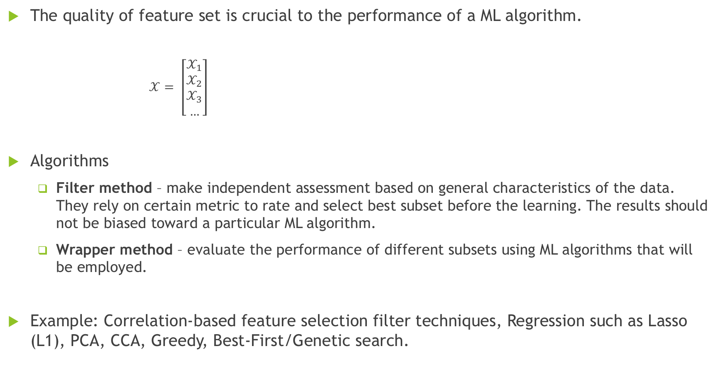
Feature selection
The quality of feature set is crucial to the performance of a ML algorithm.
$𝒳= \left[\begin{matrix}𝒳_{1} \\ 𝒳_{2} \\ \begin{aligned}𝒳_{3} \\ …\end{aligned}\end{matrix}\right]$
Algorithms
Filter method – make independent assessment based on general characteristics of the data. They rely on certain metric to rate and select best subset before the learning. The results should not be biased toward a particular ML algorithm.
Wrapper method – evaluate the performance of different subsets using ML algorithms that will be employed.
Example: Correlation-based feature selection filter techniques, Regression such as Lasso (L1), PCA, CCA, Greedy, Best-First/Genetic search.
most suitable features that characterize the data set

Slide 30
Classification
Classification algorithm seeks to classify an object into a finite set of categories.
Supervised classifiers aim to build a concise model of the class label distribution based on features of the classifiable objects.
Example: Random Forest, Support Vector Machines, Ada Boost, Decision Trees, Naïve Bayes and so forth.

Slide 31
Classification – Dataset split methodology
Dataset
Preprocessing
Training test 80%
Training 80%
Testing test 20%
Feature selection
Validation test 20%
Model building
Test parameter tuning
Model testing
Training dataset is a dataset of examples used for learning
Test set is therefore a set of examples used only to assess the performance
Validation dataset is a set of examples used to tune the parameters of a classifier

Slide 32
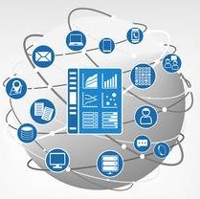
Hands-on experience - Steps
Use case description – Smart Home
Description of the dataset and collection process
What is R and R Studio? Basic commands and understanding
Traffic analysis pipeline:
Read the dataset and present the general characteristics of home network traffic
Visualizing the properties of the network files
Identifying the patterns
Feature selection techniques
Device classification
dreamstime.com

Slide 33
1. Use case: Smart Home network
Smart Home network contains a set of devices – the network traffic captures the behavior from unique perspective.
Combined together these devices they provide a broad picture of home network traffic and more importantly reveal interesting traffic activities in home networks.
http://telano.info/wp-content/uploads/2018/01/house-security-system-intended-for-my-home-connect-highlights-systems-decor-prices-project-mini-india.jpg

Slide 34
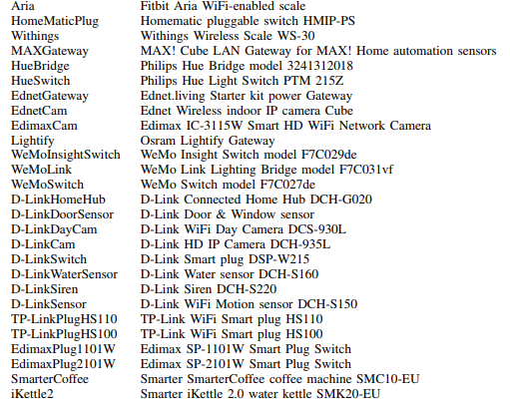

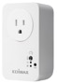


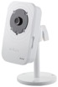
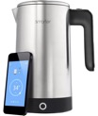
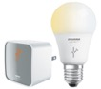
2. Dataset description
Open dataset from Aalto University School of Science, Finland ¹
Traffic from 27 smart home IoT devices such as smart camera, light, coffee maker, iKattle …
¹ https://research.aalto.fi/en/datasets/iot-devices-captures(285a9b06-de31-4d8b-88e9-5bdba46cc161).html

Slide 35
Data collection process
The typical device setup process was repeated 20 times in order to generate sufficient fingerprints for each device.
Typically, a setup procedure for a device involved:
activating the device
connecting to the device directly over Wi-Fi or Ethernet with the help of a vendor-provided application
transmitting Wi-Fi credentials to the user’s network over this connection to the device, after this
the device would typically reset and connect to the user’s network using the provided credentials

Slide 36
3. R & R Studio
R is a programming language for statistical computing and graphics
RStudio is a free and open source integrated development environment (IDE) for R
R packages
Download - https://www.rstudio.com/products/rstudio/download/

Slide 37
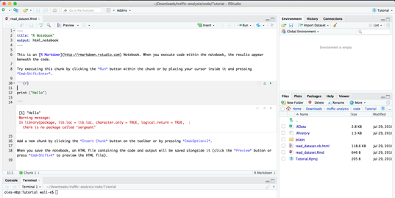
Create your first project in R Studio
File > New Project > New Directory > New Project > Create directory name and choose the path to save the project
File > New File > R Script
File > New File > R Notebook
Remove what was written in after ```{r} and before ``` and write print ("Hello there")
Execute the program: Preview > Preview Notebook
2.
3.

Slide 38
R basic commands (1/3)
Output:
> x = 10
> name = "Camera Front"
>
> mode(x)
[1] "numeric"
> length(x)
[1] 1
>
> mode(name)
[1] "character"
> length(name)
[1] 1
>
> # random integer number generator
> passgen <- function(n, m) {
+ pass <- sample(n:m, 1)
+ return (pass)
+ }
> pass = passgen(1, 10)
>
> old = 5
> if (old == pass) pass = passgen(1, 10)
else print(paste("New password is ", pass))
[1] "New password is 2"
Variables: x <- 10 or x = 10 also name <- “Camera Front”
Display the type and length use: mode(x) and length(x)
List the elements in the memory: ls()
Writing your own functions
passgen <- function(n, m) {
r <- sample(n:m, 1)
return (pass)
}
Creating condition:
if (old == pass) pass = passgen(1,10)
else print(paste(“New password is”, pass))
Creating loops:
while (x > 0) { for (I in 1:length(x)) {
... …
} }
Paradis, E. 2002. R for Beginners. Montpellier (F): University of Montpellier URL http://cran.r-project.org/doc/contrib/rdebuts_en.pdf
Notes:
You can try on your own to create while and for loops.

Slide 39
R basic commands (2/3)
Installing packages in R
install.packages(”curl") or
Tools > Install Packages … > [Type the name in the ’Packages’ box]
Call the package functionality
library(curl) or
require(curl)

Slide 40
R working with dataset (3/3)
Data objects: Vector, Factor, Matrix, Data frame, List, Time-series, Expression
Read dataset
data = read.csv(file, header = TRUE, sep = ",", quote="\"", dec=".", fill = TRUE, ...)
Get the column names of the data frame object names(data)
The data frame can accessed various ways:
data$[name of the column] # by field name or data$[name of the column][1:5] # select elements of it
data[1,] # first by row or data[1,2] # get one element
Visualize the data
x <- rnorm(10)
y <- rnorm(10)
plot(x,y)
plot(x, y, xlab="Ten random values", ylab="Ten other values", xlim=c(-2, 2), ylim=c(-2, 2), pch=22, col="red", bg="yellow", bty="l", tcl=0.4, main="How to customize a plot with R", las=1, cex=1.5)
Rossiter, D. G. (2012). Introduction to the R Project for Statistical Computing for use at ITC. International Institute for Geo-information Science & Earth Observation (ITC), Enschede (NL), 3, 3-6.

Slide 41
4. Traffic analysis pipeline
Preprocessing
Feature selection
Check for missing values (several techniques)
Convert IP address to domain names
Classification
Statistical analysis
Visual analysis – data exploration
Check correlation between features
Understanding the data
Data exploration techniques to check distribution of the data
Check and deal with outliers: statistical methods, wavelets, Principal Component Analysis or Partial Least Square
Identify destination address based on protocol and source address
Remove redundant records
Identify device type based on the highest probability
Identify mean IAT based on median, min, max, variance of IAT
Highest P
Device
Identity
Feature Extraction
Fingerprint
Prediction
Highest P
Device
Identity
Test Device
Feature Extraction
Fingerprint
Classifier
Prediction
Highest P
Device
Identity
Test Device
Feature Extraction
Fingerprint
Classifier
Prediction
Highest P
Device
Identity
Test Device
Feature Extraction
Fingerprint
Classifier
Prediction
Highest P
Device
Identity
Test Device
Feature Extraction
Fingerprint
Classifier
Prediction
Test Device
Classifier
Notes:
https://www.c-mric.com/wp-content/uploads/2018/06/Basil_Cyberincident2018.pdf
Statistical distribution and the autocorrelation function of the traffic traces: Kolmogorov-Smirnov goodness-of-fit test, autocorrelation functions, wavelet-based estimation of the Hurst parameter.

Slide 42
Read dataset (1/2)
Network traffic is captured in pcap (packet capture) file format
You can open with Wireshark ¹
Extract the fields from the pcap file using tshark command ²
Open the terminal and type
tshark -nr [path to pcap file] / [name of file].pcap -T fields -e ip.dst -e ip.src -e ip.proto> length_counts.txt
more length_counts.txt | sort -n | uniq -c > table_lengths.csv
R code
require(curl)
data <-read.csv(curl("https://raw.githubusercontent.com/CloudDemo/traffic-analysis/master/dataset_X.csv"))
head(data) # look at the first 10 rows of data
summary(data) # look at the data properties
¹ Download: https://www.wireshark.org/download.html
² Tshark synopsis: https://www.wireshark.org/docs/man-pages/tshark.html

Slide 43
Read dataset (2/2)

Slide 44
Traffic analysis pipeline - Preprocessing
Preprocessing
Feature selection
Check for missing values (several techniques)
Classification
Statistical analysis
Visual analysis – data exploration
Check correlation between features
Understanding the data
Data exploration techniques to check distribution of the data
Check and deal with outliners: statistical methods, wavelets, Principal Component Analysis or Partial Least Square
Identify destination address based on protocol and source address
Remove redundant records
Convert IP address to domain names
Identify device type based on the highest probability
Identify mean IAT based on median, min, max, variance of IAT
Highest P
Device
Identity
Feature Extraction
Fingerprint
Prediction
Highest P
Device
Identity
Test Device
Feature Extraction
Fingerprint
Classifier
Prediction
Highest P
Device
Identity
Test Device
Feature Extraction
Fingerprint
Classifier
Prediction
Highest P
Device
Identity
Test Device
Feature Extraction
Fingerprint
Classifier
Prediction
Highest P
Device
Identity
Test Device
Feature Extraction
Fingerprint
Classifier
Prediction
Test Device
Classifier

Slide 45
Preprocessing (1/2)
Check for missing values
Remove records with missing values
Replace the missing fields with column mean of that feature
# Handeling missing data
is.na(data) #returns TRUE of elements in 'data' are missing
newdata <- na.omit(data) # create new dataset without missing data
# Replace missing values with column mean
# Instead of Mean can be used Median, Standard Deviation
for(i in 1:ncol(data)){
data[is.na(data[,i]), i] <- mean(data[,i], na.rm = TRUE)
}

Slide 46
Preprocessing (2/2)
Redundant records
How many and what was the case?
Four types of network anomalies can be detected:
invalid TCP flag combinations
large number of TCP resets
UDP and TCP port scans
traffic volume anomalies
# Removing duplicate rows
duplicated(data) # Find the position
data[!duplicated(data)]
# Another method for removing duplicate rows using 'dplyr' package
install.packages("dplyr") # Install
library("dplyr") # Load
distinct(data) # Remove duplicate based on all columns
distinct(data, '') # Remove duplicated rows based on ''

Slide 47
Traffic analysis pipeline – Understanding the data
Preprocessing
Feature selection
Check for missing values (several techniques)
Classification
Statistical analysis
Visual analysis – data exploration
Check correlation between features
Understanding the data
Data exploration techniques to check distribution of the data
Check and deal with outliners: statistical methods, wavelets, Principal Component Analysis or Partial Least Square
Identify destination address based on protocol and source address
Remove redundant records
Convert IP address to domain names
Identify device type based on the highest probability
Identify mean IAT based on median, min, max, variance of IAT
Highest P
Device
Identity
Feature Extraction
Fingerprint
Prediction
Highest P
Device
Identity
Test Device
Feature Extraction
Fingerprint
Classifier
Prediction
Highest P
Device
Identity
Test Device
Feature Extraction
Fingerprint
Classifier
Prediction
Highest P
Device
Identity
Test Device
Feature Extraction
Fingerprint
Classifier
Prediction
Highest P
Device
Identity
Test Device
Feature Extraction
Fingerprint
Classifier
Prediction
Test Device
Classifier

Slide 48
Understanding the data
Visualization library – ggplot2
Types of visualizations (most used):
Scatter Plot - relationship between two continuous variables
Histogram - where and how the data points are distributed
Line Chart – progress of the data points over a period
Bar Chart – comparison between categorical variables
Tree Map – displaying hierarchical data
Area Chart - how a particular metric performed compared to a certain baseline
Flow chart produces by Dr. Andrea Abela, Chairman of the Department of Business & Economics at the Catholic University of America in Washington, DC

Slide 49
Understanding the data (1/3)
library(plyr)
library(ggplot2)
heatmap_data = ddply(data,.(App.protocol, Destination.adr, Destination.port, Source.adr, Source.port),nrow)
head(heatmap_data)
Network traffic direction can be categorized in the following groups:
Flow or uni-directional flow:
A series of packets sharing the same file-tuple: source IP, destination IP, source port, destination port, protocol
Bi-directional flow:
Is a pair or unidirectional flows going in the opposite directions between the same source and destination IP.
Full-flow:
A bi-directional flow captured over its entire lifetime, from establishment to the end of the communication connection.
heatmap_data$protocol = factor(heatmap_data$protocol)
ggplot(heatmap_data, aes(x = heatmap_data$protocol)) + geom_bar() + xlab('Protocol type') + ylab('Total number of packets')
Bar chart visualization

Slide 50
Understanding the data (2/3)
Scatter plot visualization
# List all the devices and protocol type usage
heatmap_port = ddply(heatmap_data,.(source.adr, protocol),nrow)
ggplot(data=heatmap_port, aes(x=Protocol, y=SourceAdr)) + geom_point() + xlab('Protocol') + ylab('Source IP’)
# List selected devices per MAC address
selected = heatmap_data[heatmap_data$source.adr == "74:da:38:80:79:fc" | heatmap_data$source.adr == "74:da:38:80:7a:08" | heatmap_data$source.adr == "'b0:c5:54:1c:71:85" | heatmap_data$source.adr == "b0:c5:54:25:5b:0e" | heatmap_data$source.adr == "5c:cf:7f:07:ae:fb" | heatmap_data$source.adr == "5c:cf:7f:06:d9:02", ]
heatmap_port = ddply(selected,.(Source.adr, App.protocol),nrow)
names(heatmap_port) <- c('SourceAdr', 'Protocol', 'Freq’)
ggplot(data=heatmap_port, aes(x=Protocol, y=SourceAdr)) + geom_point() + xlab('Protocol') + ylab('Source IP')
D-LinkCam
EdimaxCam
EdimaxCam
SmarterCoffee
iKettle2

Slide 51
Understanding the data (3/3)
IAT – Inter Arrival Time
The time between the “start” of two events.
In network context the time between arrival time of two packages.
previous = 0
IA_times = c()
j = 0
for (i in 1:dim(data)[1]) {
if (previous == 0) {
previous = data[i,4]
} else {
j = j + 1
IA_times[j] = data[i,4] - previous
previous = data[i,4]
}
}
IAT_times <- as.data.frame(IA_times)
ggplot(IAT_times, aes(x=IAT_times$c, y=IAT_times$IA_times)) +
geom_line(color='steelblue') +
xlab('Number of packets') + ylab('Inter Arrival Time')
Line chart visualization

Slide 52
Traffic analysis pipeline – Feature selection
Preprocessing
Feature selection
Check for missing values (several techniques)
Classification
Statistical analysis
Check correlation between features
Understanding the data
Data exploration techniques to check distribution of the data
Check and deal with outliners: statistical methods, wavelets, Principal Component Analysis or Partial Least Square
Remove redundant records
Convert IP address to domain names
Visual analysis – data exploration
Identify destination address based on protocol and source address
Identify mean IAT based on median, min, max, variance of IAT
Identify device type based on the highest probability
Highest P
Device
Identity
Feature Extraction
Fingerprint
Prediction
Highest P
Device
Identity
Test Device
Feature Extraction
Fingerprint
Classifier
Prediction
Highest P
Device
Identity
Test Device
Feature Extraction
Fingerprint
Classifier
Prediction
Highest P
Device
Identity
Test Device
Feature Extraction
Fingerprint
Classifier
Prediction
Highest P
Device
Identity
Test Device
Feature Extraction
Fingerprint
Classifier
Prediction
Test Device
Classifier

Slide 53
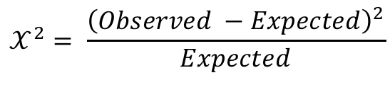
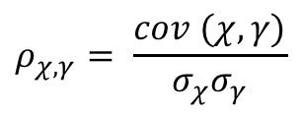
Feature selection (1/5)
Results
Pearson Correlation - is a number between -1 and 1 that indicates the extent to which two variables are linearly related.
Chi-Square - is used to determine relationship between two variables.
Traffic analysis
Feature vector
$$ρ_{χ, γ}= \frac{cov (χ, γ)}{σ_{χ}σ_{γ}}$$
Post processing
Packet/Flow Data
Traffic observations
$$𝒳^{2}= \frac{{\left(Observed −Expected\right)}^{2}}{Expected}$$
Probability of having those results considering the null hypothesis is true, which is the variables are not associated.

Slide 54
Feature selection (2/5)
Filter method analysis using Pearson’s correlation with package ‘caret’
library(caret)
correlationMatrix <- cor(basic.features[,5:7]) # calculate correlation matrix
print(correlationMatrix) # summarize the correlation matrix
# find attributes that are highly corrected (ideally >0.75)
highlyCorrelated <- findCorrelation(correlationMatrix, cutoff=0.5)
print(highlyCorrelated) # print indexes of highly correlated attributes

Slide 55
Feature selection (3/5)
Filter method analysis using Chi-Square correlation with package ‘MASS’
library(MASS)
tbl = table(selected$V1, selected$V2)
print(tbl)
chisq.test(tbl) # is the destination IP independent of the protocol at .05 significance level

Slide 56
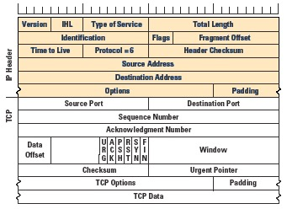
Feature selection (4/5)
Wrapper analysis using regression technique with package ‘‘gml’
We used features from TCP/IP Header, packet time, and IAT value
# Fit a logistic regression model
fit_glm = glm(selected$V1 ~ selected$V5, family = "binomial”, selected)
summary(fit_glm) # generate summary
Fonti, V., & Belitser, E. (2017). Feature selection using lasso. VU Amsterdam Research Paper in Business Analytics.

Slide 57
Feature selection (5/5)
For loop going through all the variables as potentials for finding which features is more relevant
#No. of cols in data frame
c <- ncol(selected)
# Intializing the vector which will contain the p-values of all variables
pvalues <- numeric(c)
# Getting the p-values
for (i in 1:c) {
fit <- glm(selected$V1 ~ selected[,i], selected, family = "binomial")
summ <- summary(fit)
pvalues[i] <- summ$coefficients[2,4]
}
ord <- order(pvalues)
x10 <- selected[,ord]
names(x10)

Slide 58
Traffic analysis pipeline - Classification
Preprocessing
Feature selection
Check for missing values (several techniques)
Classification
Statistical analysis
Visual analysis – data exploration
Check correlation between features
Understanding the data
Data exploration techniques to check distribution of the data
Check and deal with outliners: statistical methods, wavelets, Principal Component Analysis or Partial Least Square
Identify destination address based on protocol and source address
Remove redundant records
Convert IP address to domain names
Identify mean IAT based on median, min, max, variance of IAT
Identify device type based on the highest probability
Highest P
Device
Identity
Feature Extraction
Fingerprint
Prediction
Highest P
Device
Identity
Test Device
Feature Extraction
Fingerprint
Classifier
Prediction
Highest P
Device
Identity
Test Device
Feature Extraction
Fingerprint
Classifier
Prediction
Highest P
Device
Identity
Test Device
Feature Extraction
Fingerprint
Classifier
Prediction
Highest P
Device
Identity
Test Device
Feature Extraction
Fingerprint
Classifier
Prediction
Test Device
Classifier

Slide 59
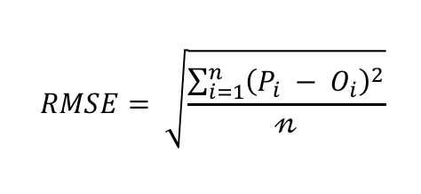
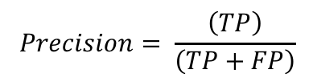
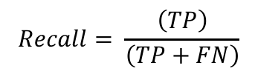
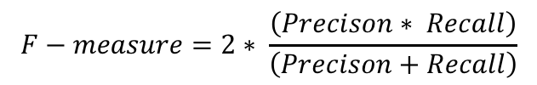
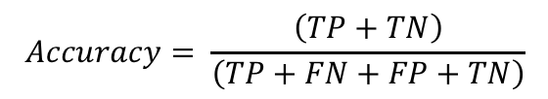
Classification (1/4)
Another used metric is Root Mean Square Error (RMSE), that measure the differences between values predicted by the model Pi and observed values Oi.
$$RMSE= \sqrt{\frac{\sum_{i=1}^{n}{{\left(P_{i} − O_{i}\right)}^{2}}}{𝓃}}$$
A common way to characterize a classifier’s accuracy is through metrics known as False Positives (FP), False Negatives (FN), True Positives (TP), and True Negatives (TN) by using confusion matrix.
ML literature often utilizes three additional metrics known as Recall, Precision, and F-measure.
Classified as -> | X | Y
X | TP | FN
Y | FP | TN
$$Recall= \frac{\left(TP\right)}{\left(TP+FN\right)}$$
$$Accuracy= \frac{\left(TP+TN\right)}{\left(TP+FN+FP+TN\right)}$$
$$Precision= \frac{\left(TP\right)}{\left(TP+FP\right)}$$
$$F−measure=2∗ \frac{\left(Precison∗ Recall\right)}{\left(Precison+Recall\right)}$$
Confusion matrix

Slide 60
Classification (2/4)
Identify protocol used based on the destination address using decision tree algorithm
# load the required libraries
library(rpart)
suppressPackageStartupMessages(library(Metrics)) # Used for calculating root mean squared log error
suppressPackageStartupMessages(library(caret)) # For data partition
suppressPackageStartupMessages(library(rpart.plot)) # For plotting the model
selected$V1 = as.integer(selected$V1)
train_set = selected[1:5917,]
test_set = selected[5917:6574,]
model_rf <- rpart(V1 ~ V2,data=train)
cv_prediction_set <- predict(model_rf,cv_set)

Slide 61
Classification (3/4)
Calculate the error
library(Metrics)
rmse <- sqrt(mean((cv_set$V1 - cv_prediction_set) ^ 2)) or
rmse <- rmse(test_set$V1, prediction_set)
paste("The root mean square error is", rmse,sep=" ")
rpart.plot(model_rf)

Slide 62
Classification (4/4)
Identify protocol used based on the destination address using Random Forest aalgorithm
# Random Forest classifier
library(randomForest)
#applying Random Forest
model_rf <- randomForest(V1 ~ V2, data = train_set)
preds <- predict(model_rf,test_set)
table(preds)
accuracy(preds, test_set$V1) #checking accuracy

Slide 63
Take a ways from Theoretical Part – Things to remember
IoT systems are more and more present in our daily life and we need to be informed how to use it and what are the security and privacy risks
There are methods that can help to protect our privacy and security
ML techniques can help us to develop a tools that can help to protect our privacy and security
Notes:
70/80 – 75/85

Slide 64
Take a ways from Practical Part – Things to remember
This work presented several steps that should be considered when pre-processing raw network traffic data for data mining.
Some of these steps are essential, some others can be optional.
Provided a case study using a freely available dataset.
We show basic information of using R and R Studio environment – platform mostly used by statistician
We show how to use one of the most widely used ML algorithm Random Forest
Results show the steps are indeed key to obtaining reliable results.

Slide 65
References
Wired
https://www.wired.com/story/firewalls-dont-stop-hackers-ai-might/
https://www.wired.com/story/ai-machine-learning-cybersecurity/
RStudio videos and examples
https://github.com/rstudio/webinars
Visualizations in R
Top 50 ggplot2 Visualizations - http://r-statistics.co/Top50-Ggplot2-Visualizations-MasterList-R-Code.html
Smart Home
Amar, Y., Haddadi, H., Mortier, R., Brown, A., Colley, J., & Crabtree, A. (2018). An Analysis of Home IoT Network Traffic and Behaviour. arXiv preprint arXiv:1803.05368.
Network traffic analysis
Nguyen, T. T., & Armitage, G. (2008). A survey of techniques for internet traffic classification using machine learning. IEEE Communications Surveys & Tutorials, 10(4), 56-76.
Mohammadi, M., Al-Fuqaha, A., Sorour, S., & Guizani, M. (2018). Deep Learning for IoT Big Data and Streaming Analytics: A Survey. IEEE Communications Surveys & Tutorials.

Slide 66

Thank you a lot!
Questions
Email: kolivera@ieee.org

